Slide 1
http://www.vidyanidhi.com/
ketkiacharya.net@gmail.com
Ketki Acharya
From: SM VITA ATC of CDAC
9769201036
ketkiacharya.net@gmail.com

Slide 2
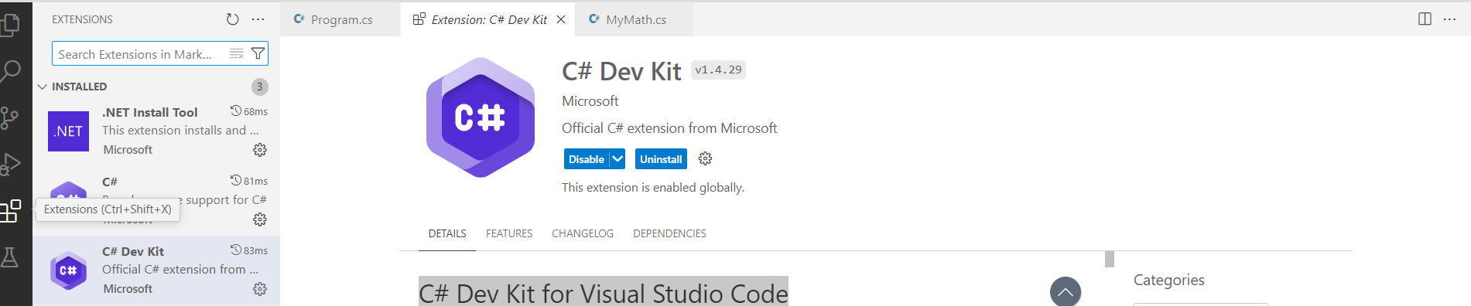
Click on extension and type c# dev Kit and install it

Slide 3
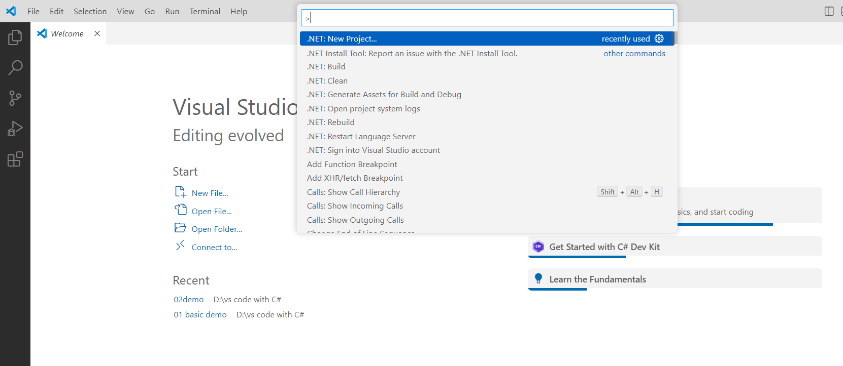
Click on View
Click on command Palette
Type .Net Project

Slide 4
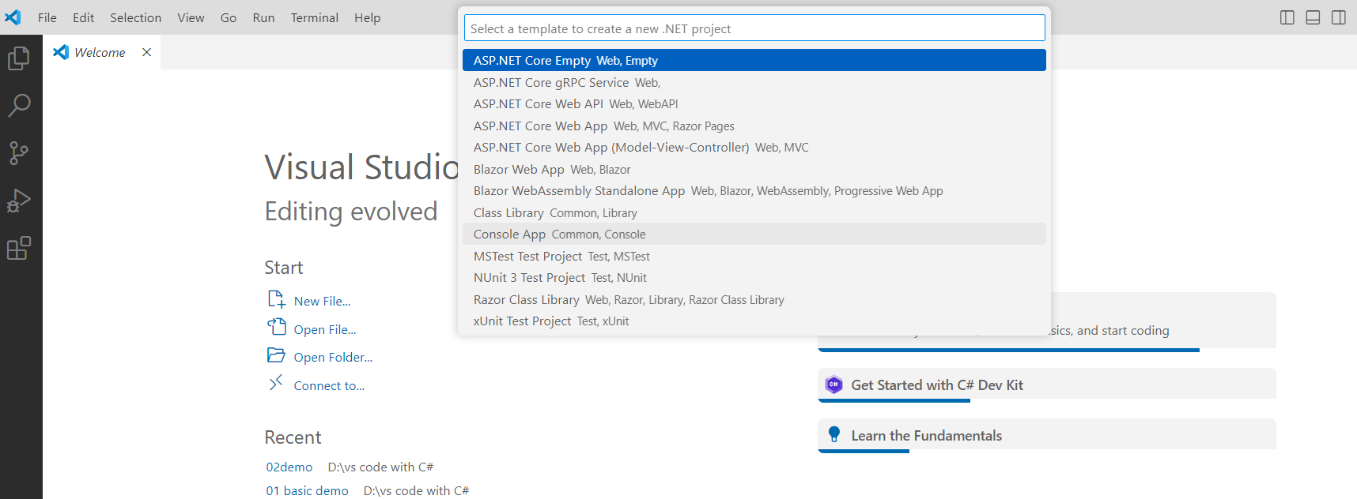
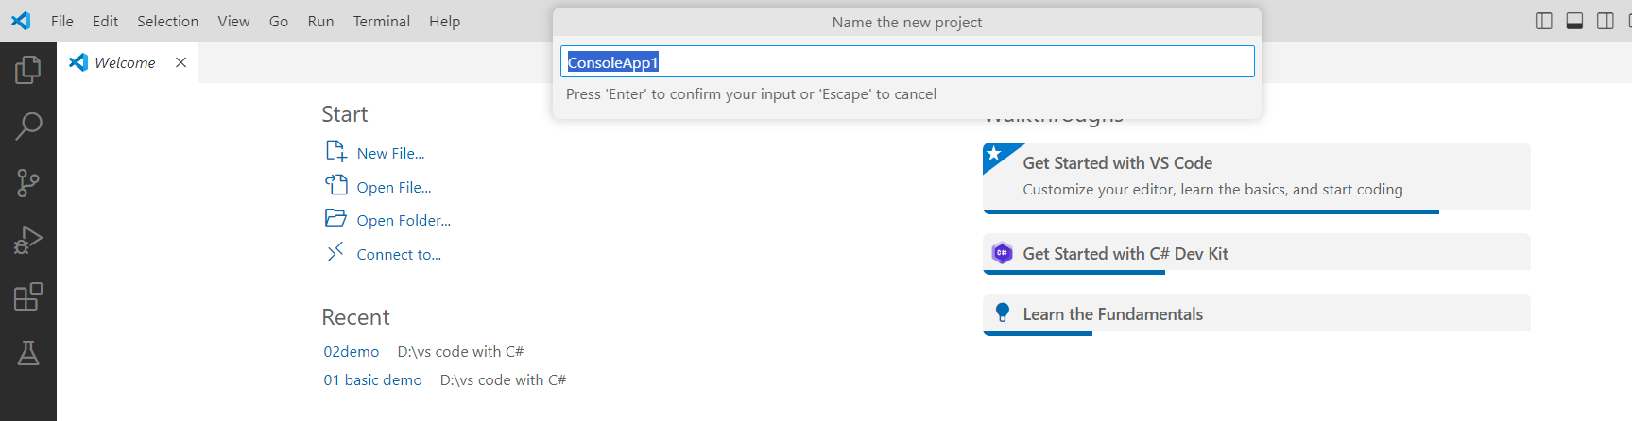
Select Console App Common Console
Then it will open window explorer
You have to select folder in which it will create your project
Type project name , it will create a folder with that project name

Slide 5
Run the application

